Slide 1
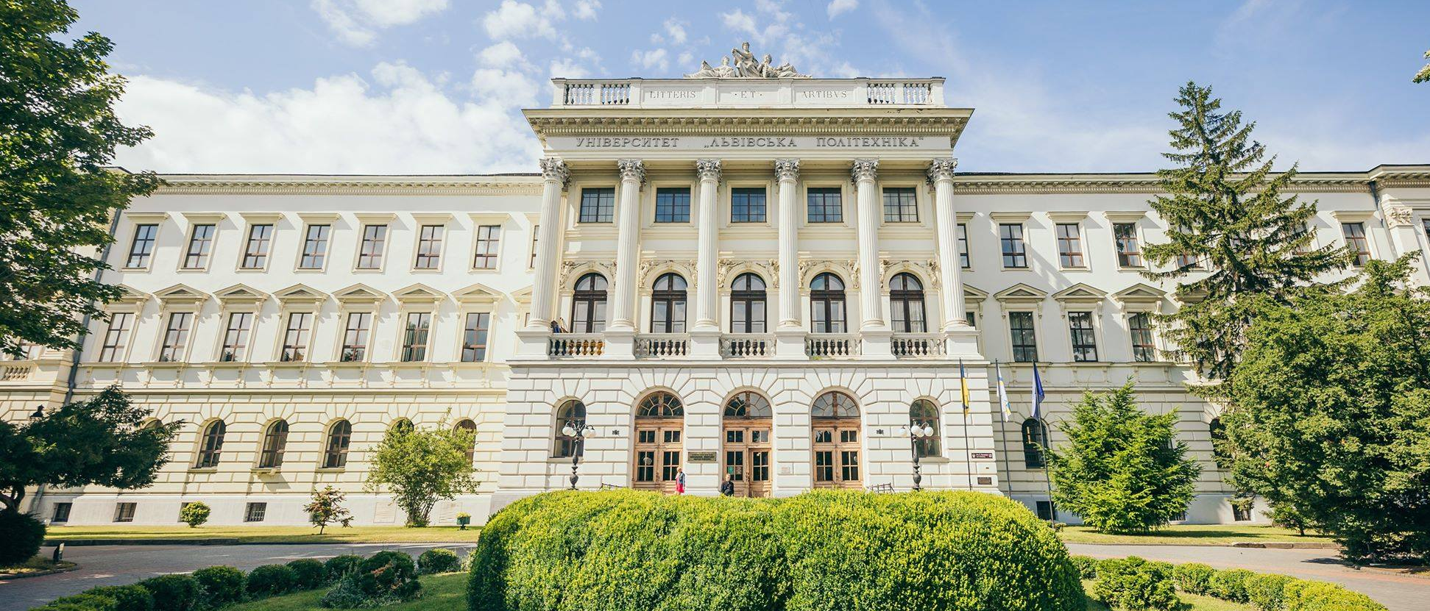
LVIV POLYTECHNIC NATIONAL UNIVERSITY
200+ years of experience and traditions

Slide 2
UNIVERSITY OF FOURTEEN TITLES
1816-1825
Tsisar-Royal Real School in Lviv
1825-1835
Tsisar-Royal Real School of Technical Sciences and Trade in Lviv
1835-1844
Tsisar-Royal Real-Trade Academy in Lviv
1844-1877
Tsisar-Royal Technical Academy in Lviv
1877-1894
Tsisar-Royal Higher Technical School in Lviv
1894-1921
Tsisar-Royal Polytechnic School in Lviv
1921-1939
Lviv Polytechnic
1939-1942
Lviv Polytechnic Institute
1942-1944
Professional Technical Courses in Lviv
1944-1967
Lviv Polytechnic Institute
1967-1978
The Order of Lenin Lviv Polytechnic Institute
1978-1993
The Order of Lenin Lviv Polytechnic Institute named after Lenin Komsomol
1993-2000
Lviv Polytechnic State University
2000-2025
Lviv Polytechnic National University

Slide 4
STRATEGIC DEVELOPMENT PLAN
MISSION: to raise future leaders able to work wisely, creatively, effectively
VISION: to become the leading university in Ukraine while topping the international and national rankingsЦІЛІ:
OBJECTIVES: to attract talented young people motivated to study at the university
to create study and work-friendly atmosphere for personal growth and development
to improve the professional quality and productivity of the personnel, increase the percentage of young scientists in research and academic teaching staff
to top the list of among national universities in the relation to the amount of completed international grants
to increase the university presence and visibility in the global multimedia information space
VALUES:
PROFESSIONALISM
PATRIOTISM
INTEGRITY
ACADEMIC FREEDOM
WILLINGNESS TO CHANGE
SPIRITUALITY
TRADITIONS

Slide 5
THE UNIVERSITY AND ITS COMMUNITY TODAY
33 702
students of Bachelor's and Master’s degrees of higher education
2040
Postgraduate and Doctoral students
121
international students, postgraduate students, and students of preparatory courses
2460
full-time research and academic teaching staff
68
full-time research staff
Lviv Polytechnic National University

Slide 6
LVIV POLYTECHNIC NATIONAL UNIVERSITY IN RANKINGS
 | Ranking position in the world (number of HEIs) | Ranking position in Ukraine (number of HEIs)
У міжнародних рейтингах
Times Higher Education World University Rankings | 1501+ (2000) | 2 (17)
Times Higher Education World University Rankings 2024 by Subject
Computer science | 201-250 (1027) | 1 (8)
Business & Economics | 301-400 (909) | 2 (6)
Engineering | 601-800 (1374) | 2 (11)
Physical sciences | 601-800 (1370) | 2 (11)
Social sciences | 801+ (997) | 3 (3)
Times Higher Education Impact Rankings | 601-800 (2152) | 2 (42)
QS World University Rankings 2025 | 1001-1200 (1500) | 4 (11)
QS World University Rankings 2024 by Subject
Engineering – Petroleum | 101-150 (160) | 1 (1)
Computer Science and Information Systems | 451-500 (722) | 2 (6)
QS World University Rankings: Sustainability 2025 | 715 (1743) | 1 (17)
QS Europe Region University Rankings 2025 | 424 (684) | 5 (36)
QS World University Rankings: Eastern Europe 2025 | 46 (133) | 5 (36)
Webometrics Ranking of World Universities 2024 | 3086 (11996) | 11 (292)
UI GreenMetric World University Rankings 2024 | 701 (1477) | 5 (25)
У національних рейтингах
Ranking according to SciVerse Scopus 2024 | 9 (214)
Academic Ranking "TOP-200 Ukraine« 2024 | 3 (200)
Consolidated Ranking of Higher Education Institutions in Ukraine 2024 | 3 (235)

Slide 7
EDUCATIONAL ACTIVITY
68
specialities of higher education
256
Bachelor’s and Master’s educational programs (including 38 in English)
55
education and research programs for the preparation of Doctors of Philosophy
11472
students and postgraduate students enrolled in the university
8666
graduates of Bachelor’s and Master’s degrees of higher education
Lviv Polytechnic National University

Slide 9
ACADEMIC INSTITUTES OF LVIV POLYTECHNIC
INSTITUTE OF PUBLIC ADMINISTRATION, GOVERNANCE AND PROFESSIONAL DEVELOPMENT (IPAG)
INSTITUTE OF ARCHITECTURE AND DESIGN (IARD)
INSTITUTE OF CIVIL ENGINEERING AND BUILDING SYSTEMS (CEBS)
INSTITUTE OF GEODESY (IGD)
INSTITUTE OF THE HUMANITIES AND SOCIAL SCIENCES (IHSS)
INSTITUTE OF ECONOMICS AND MANAGEMENT (IEM)
INSTITUTE OF POWER ENGINEERING AND CONTROL SYSTEMS (IPEC)
INSTITUTE OF COMPUTER SCIENCE AND INFORMATION TECHNOLOGIES (ICSIT)
INSTITUTE OF COMPUTER TECHNOLOGIES, AUTOMATION AND METROLOGY (ICTA)
INSTITUTE OF INFORMATION AND COMMUNICATION TECHNOLOGIES AND ELECTRONIC ENGINEERING (ICTE)
INSTITUTE OF ENGINEERING MECHANICS AND TRANSPORT (IMET)
INSTITUTE OF PRINTING ART AND MEDIA TECHNOLOGIES (IPMT)
INSTITUTE OF JURISPRUDENCE AND PSYCHOLOGY AND INNOVATIVE EDUCATION (IJPSIE)
INSTITUTE OF APPLIED MATHEMATICS AND FUNDAMENTAL SCIENCES (IMFS)
VIACHESLAV CHORNOVIL INSTITUTE OF SUSTAINABLE DEVELOPMENT (ISD)
INSTITUTE OF CHEMISTRY AND CHEMICAL TECHNOLOGIES (ICCT)

Slide 11
UNIVERSITY INFRASTRUCTURE
34
educational and research buildings
19
hostels
1
Innovative centre of Tech StartUp School
2
libraries
1
astronomical observatory
1
geodetic landfill
1
publishing house
4
training and health camps
Lviv Polytechnic National University

Slide 12
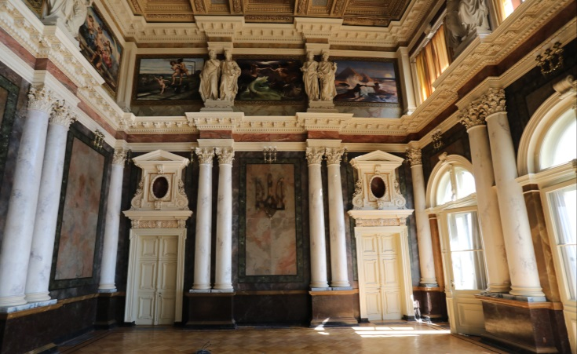
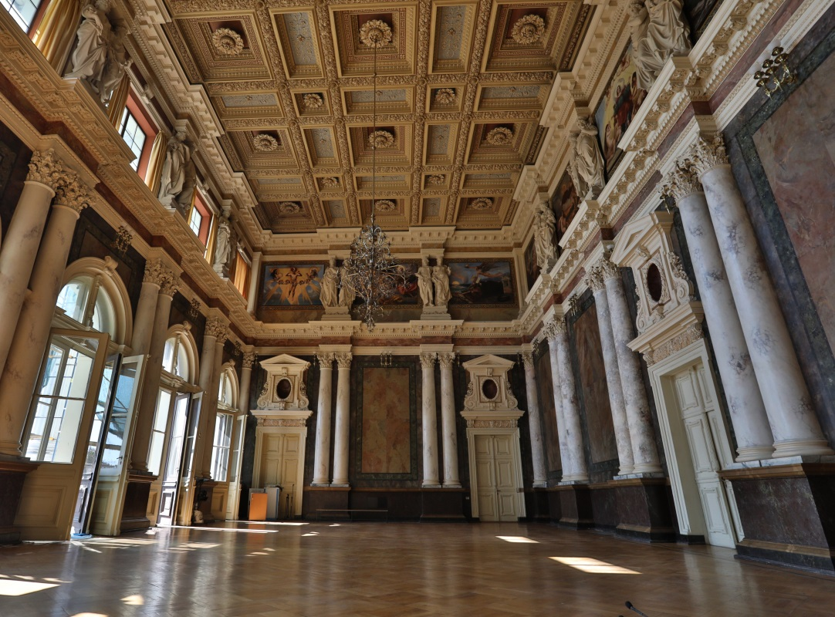
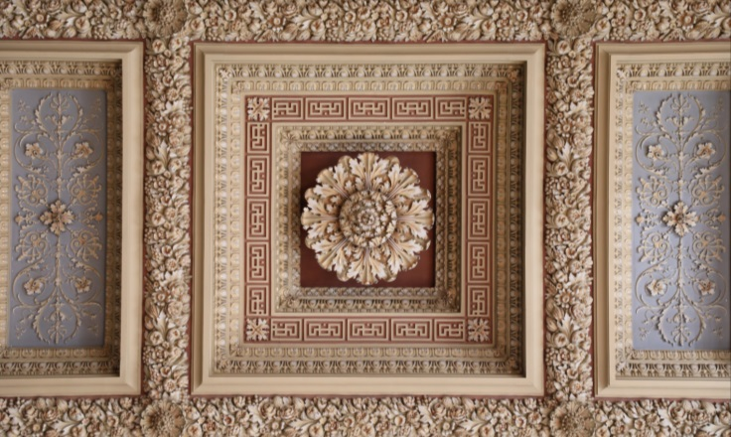
UNIQUE HALLS OF LVIV POLYTECHNIC
ASSEMBLY HALL

Slide 13
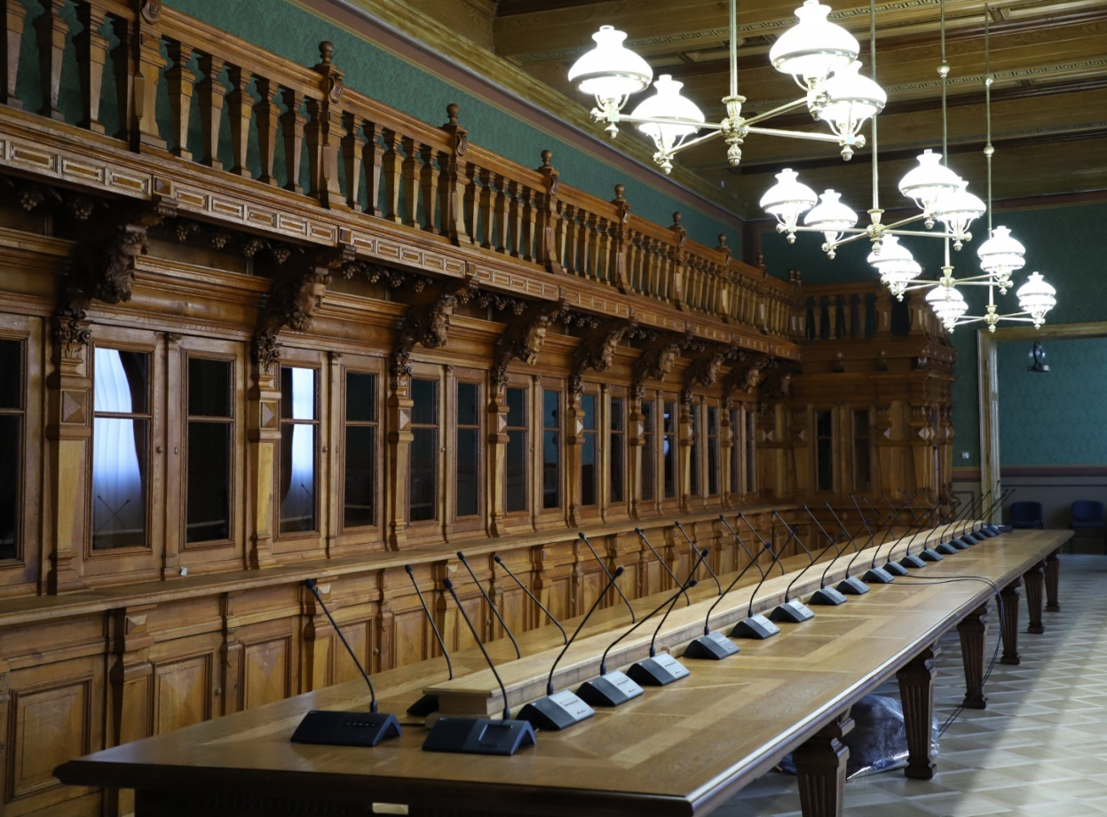
UNIQUE HALLS OF LVIV POLYTECHNIC
JULIAN ZACHARIEWICZ HALL

Slide 14
RESEARCH ACTIVITY IN 2024
39
research work performed at the expense of the state general funds
200 +
research contracts
27
international research projects and collective grants
260
monographs
1743
articles in publications included in the international scientometric databases Scopus and Web of Science
Lviv Polytechnic National University

Slide 16
INTERNATIONAL COOPERATION
442
international cooperation agreements with higher education institutions and organisations in 43 countries
673
research and academic teaching staff
have been trained in foreign institutions
113
foreign specialists took part in the Visiting Professor and Guest Lecturer Programmes at Lviv Polytechnic
85
international collective and individual educational and social grants, projects, scholarships
Lviv Polytechnic National University

Slide 18
FOR THE POLYTECHNIC COMMUNITY AND UNIVERSITY FRIENDS,
A RANGE OF EVENTS ARE HELD EVERY YEAR
MARCH
Lviv Polytechnic Day
APRIL
Scientific Festival
MAY
Spring Polytechnic Festival
JUNE
Alumni Forum
SEPTEMBER
Freshman Day
OCTOBER
ECOweekend
NOVEMBER
Autumn Polytechnic Festival
NOVEMBER
Students’ Day
DECEMBER
Awarding Ceremony "Lviv Polytechnic Benefactor of the Year"
THROUGHOUT THE YEAR
The Prosvita People’s House Artistic Activity
Lviv Polytechnic National University

Slide 20
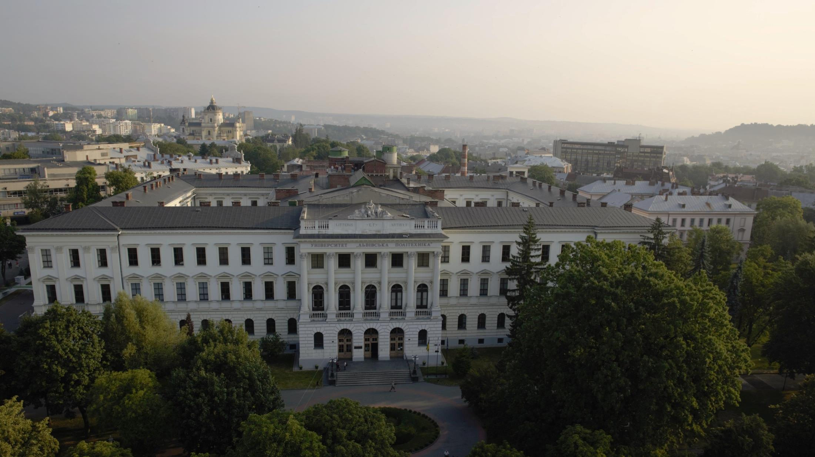
⁷⁹⁰¹³
^{Lviv, Ukraine, Bandera Str. 12}
(032) 258-26-80, coffice@lpnu.ua
^{http://lpnu.ua}

