Slide 1
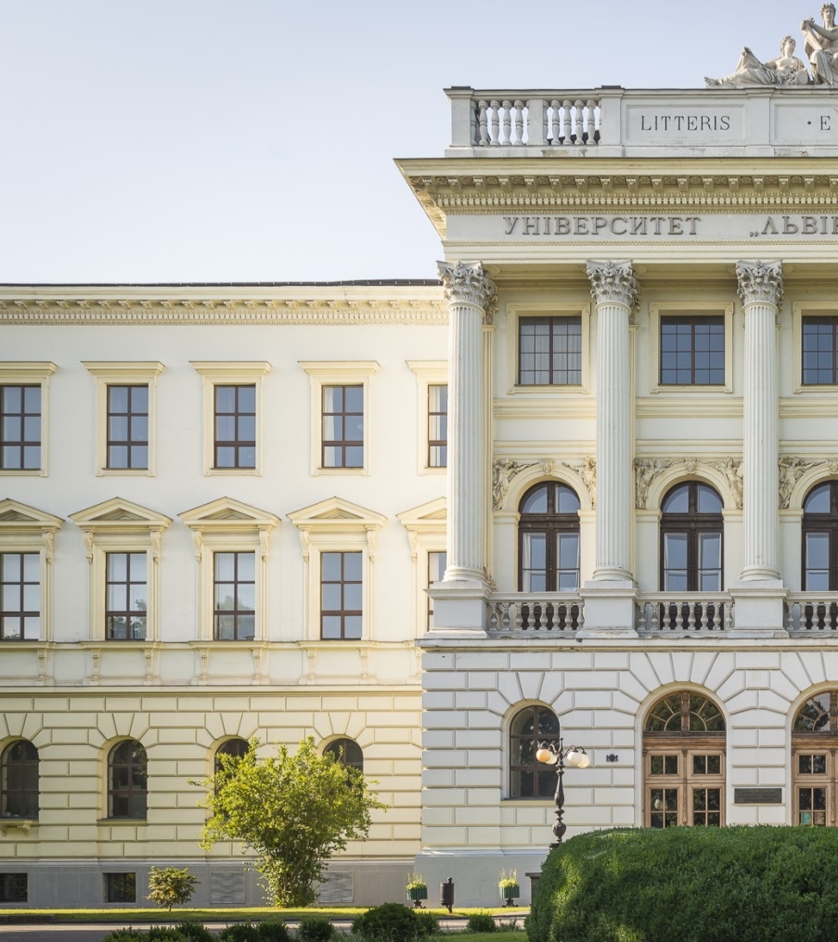
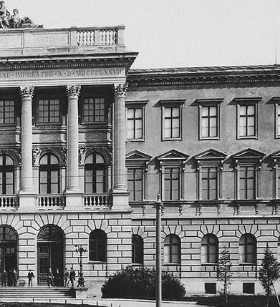
HISTORY OF LVIV POLYTECHNIC

Slide 2
UNIVERSITY OF FOURTEEN TITLES
1816-1825
Tsisar-Royal Real School in Lviv
1825-1835
Tsisar-Royal Real School of Technical Sciences and Trade in Lviv
1835-1844
Tsisar-Royal Real-Trade Academy in Lviv
1844-1877
Tsisar-Royal Technical Academy in Lviv
1877-1894
Tsisar-Royal Higher Technical School in Lviv
1894-1921
Tsisar-Royal Polytechnic School in Lviv
1921-1939
Lviv Polytechnic
1939-1942
Lviv Polytechnic Institute
1942-1944
Professional Technical Courses in Lviv
1944-1967
Lviv Polytechnic Institute
1967-1978
The Order of Lenin Lviv Polytechnic Institute
1978-1993
The Order of Lenin Lviv Polytechnic Institute named after Lenin Komsomol
1993-2000
Lviv Polytechnic State University
2000-2025
Lviv Polytechnic National University

Slide 3
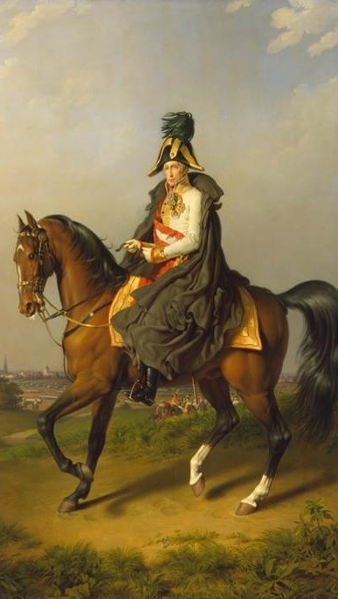
REAL SCHOOL
The appearance of specialized technical institutions in the Austrian and German Empires fostered the establishment of real schools with the intention to prepare learners for entering higher technical educational institutions. In March 1816, the courtier educational commission sent an order to Lviv:
“It is the right time to advance the level of a normal school in Halychyna and Krakiv… The institution will provide sustainable, long-term studying and will become a center of science, trade, business management, professional teaching… It is time to announce the initiation of a real school in Lviv"
The courtier commission proclaimed that by his order on March 7, 1816, in Milan, Tsisar Franz I allowed the establishment of the 1st class of a real school in Lviv (1816-1817) to be located in the building of the Normal School on Castrum Square.
In 1835, by the efforts of the Regional Sejm, the real school was reorganized into the “Tsisar-Royal Real-Trade Academy”, with the rank of a gymnasium.

Slide 4
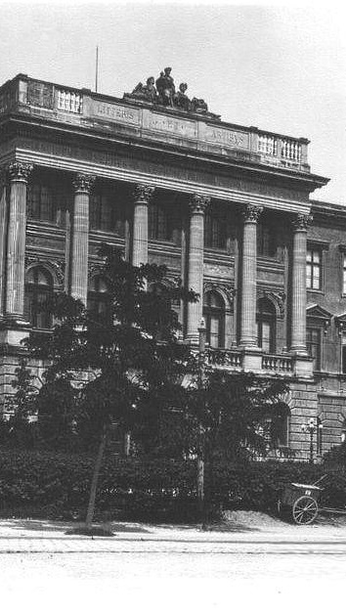
TECHNICAL ACADEMY
By a rescript of January 24, 1843, Tsisar allowed to establish a Technical Department (faculty), and by a resolution of February 3, 1844 it was permitted to establish the Technical Academy. On November 4, 1844, the academy solemnly began its studies and became the first technical educational institution of the academic model in Ukraine.
In November 1871, the academy obtained the rights of a higher educational institution of the Austrian and Hungarian monarchy. It broadened the institution autonomy: the board of professors received the right to elect a rector for one year.
In 1874, the construction of the premises of Technical Academy began. Simultaneously, a chemical laboratory building was being erected. The project was commissioned to be elaborated by a lecturer of the academy, an architect Julian-Octavian Zakharievych. On November 15, 1877, a grand opening took place of new premises of Technical Academy. The building was designed in the style of Neo-Renaissance, with 6 columns of the Corinthian order, which support the attic. It is crowned by an allegorical sculptural composition Engineering, Architecture and Mechanics by Leonardo Marconi. The assembly hall was decorated with paintings after the sketches of the famous Polish artist Jan Matejko.

Slide 5
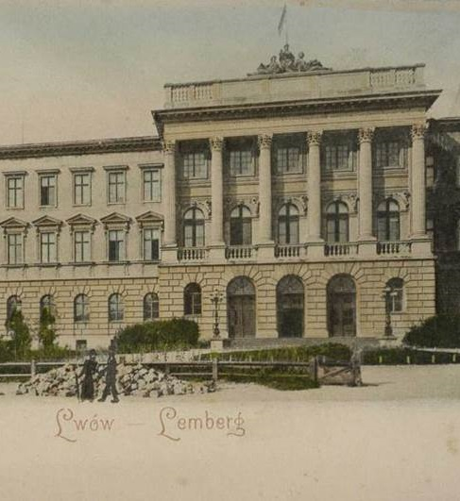
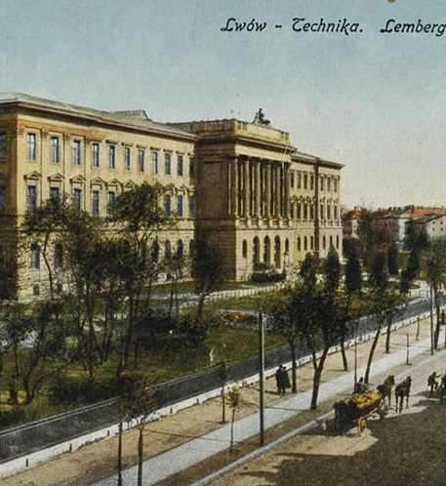

Slide 6
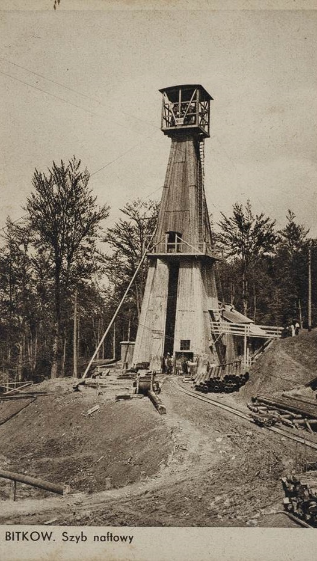
TSISAR-ROYAL HIGHER TECHNICAL SCHOOL
By a government decree of October 8, 1877, following the proposal of the Board of Professors, the educational institution was renamed into the Tsisar-Royal Higher Technical School.
The policy of the educational institution faced transformations as well. According to the Swiss model, three departments (faculties) were established: Engineering, Architecture and Technical Chemistry. Later, in 1877, a machine-building department was founded, and in 1907 studies were initiated at the Water Engineering Department. To meet the practical needs and standards of industry at the Higher Technical School, there were established three Regional research stations: oil, ceramic and mechanical.
Since 1901, a rector of the Higher Technical School obtained a mandate in the Halychyna Regional Sejm. The same year, the Higher Technical School received the right to accredit the degree of Doctor of Technical Sciences, on the basis of scientific work and previous successful examination. By the year 1918, 64 engineers received this degree. Moreover, in 1912, the Higher Technical School began to award the honorary title of Doctor honoris causa; among the first awarded were Marie Sklodowska-Curie, J. Franke, J. Medvedskyy, A. Vitkovskyy, and K. Obrembovych.

Slide 7
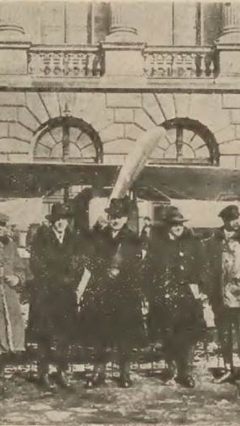
WARTIME PERIOD
With the beginning of the First World War in June 1914, the buildings of the Higher Technical School were converted into a military hospital. The majority of lecturers and students left Lviv or got mobilized to the army. Within 1915-1917, the Higher Polytechnic School restored its work despite the fact that a part of the school buildings remained occupied for the needs of a military hospital.
On January 13, 1921, the Ministry of Education of the Second Rzeczpospolyta renamed the Higher Technical School into Lviv Polytechnic.
The beginning of the Second World War and the events of the “Golden September” (occupation of the western Ukrainian lands of the Second Rzeczpospolyta by the Red Army troops) marked a new circle of life for the school. In October 1939, the educational process was renovated, and the name was changed into Lviv Polytechnic Institute. The first Soviet period was interrupted by the arrival of German occupation troops in June 1941. As during the First World War, a hospital was located in the Polytechnic buildings. On the Vuletsky Hills in July 1941, dozens of lecturers and scientists of Lviv Polytechnic were shot dead by German repressive services.
In April 1942, the German occupation authorities allowed to organize Professional Technical Courses with a limited lecturing program in the premises of the current building № 14.

Slide 8
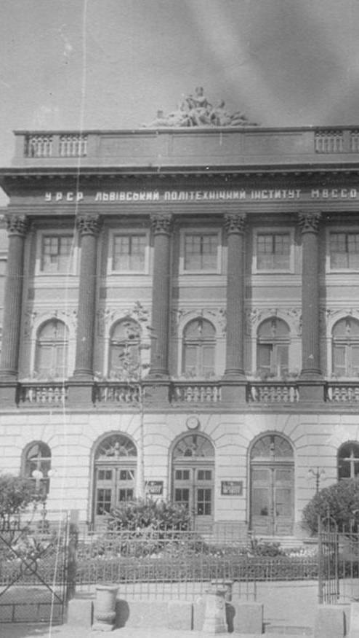
THE SOVIET PERIOD
With the return of Soviet authority in the summer of 1944, the restoration of the school began, which eventually marked its new establishment. As a result of the Soviet recruitment policy, there was not a single Ukrainian with a scholarly degree among the lecturers of Lviv Polytechnic Institute. As of September 1945, more than a hundred of new lecturers had been admitted to the institute. This contributed to the strong Russification of the educational process at Polytechnic Institute.
At the beginning of the 1970s, LPI consisted of 14 faculties: Energetic, Electrophysical, Electromechanical, Radio Engineering, Mechanical Technology, Mechanical Engineering, Civil Engineering, Geodesy, Engineering Economics, Chemical Technology, Technology of Organic Matter, Automation. Evening schooling and extramural education were also introduced (opened in 1956).
About 25 thousand students studied at 14 faculties and branches of LPI. During 1986 and 1987 academic year, lectures were delivered by 1412 lecturers, among which there were 59 doctors of sciences, professors and 752 candidates of sciences and associate professors. In 1988, LPI hosted 72 basic departments and 65 research laboratories.
Since 1989, democratization processes gained strength within the walls of Lviv Polytechnic Institute. Under the pressure of student actions of disobedience, ideological norms in the preparation of curricula witnessed revision; an outflow of members from communist and Komsomol organizations took place.

Slide 9
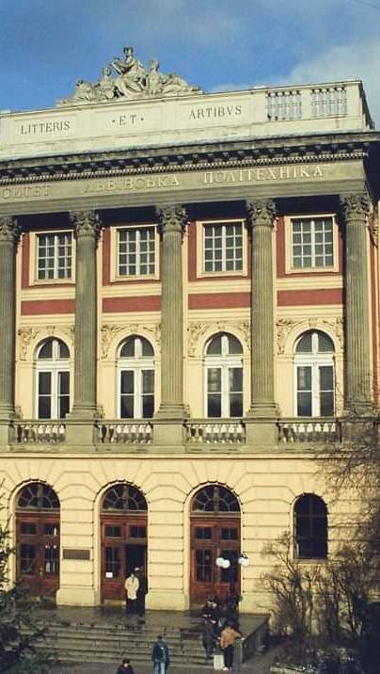
FORMATION OF INDEPENDENCE
On the basis of the Statute, on February 27, 1991, the first democratic elections after 1945 took place. Professor, Doctor of Physical and Mathematical Sciences Yuriy Rudavskyy became a rector. Under his leadership, the formation of the Ukrainian higher school emerged.
The proclamation of independence on August 24, 1991 and the creation of a new state system of educational institutions marked a new period of transformation. Only since then has Lviv Polytechnic Institute started working under the conditions of the Ukrainian independent state.
In June 1993, Lviv Polytechnic Institute received the highest – the fourth – level of accreditation, as well as a new name - Lviv Polytechnic State University.
For the first time in Ukraine, in March 1993, the body of student self-government was elected at Lviv Polytechnic – the Board of students of the institute, faculties and student councils of hostels. New faculties were created: Computer Engineering and Information Technology, Applied Mathematics. The First Academic Gymnasium at Lviv Polytechnic was revived.

Slide 10
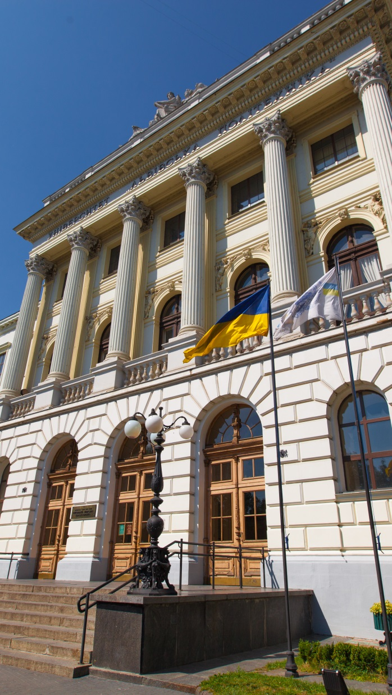
21ST CENTURY
In 2000, the University acquired a national status.
September 2001 was marked by the process of reorganization of Lviv Polytechnic structure: instead of 16 faculties, 12 educational and scientific institutes were established.
Since 2007, the university has been headed by Professor Yuriy Bobalo.
On July 8, 2009, the Cabinet of Ministers of Ukraine granted Lviv Polytechnic National University the status of a research national higher education institution.
In 2020, the University adopted a new strategic development plan for 5 years covering ambitious plans and goals.

Slide 11

STRATEGIC DEVELOPMENT PLAN
MISSION: to raise future leaders able to work wisely, creatively, effectively
VISION: to become the leading university in Ukraine while topping the international and national rankingsЦІЛІ:
OBJECTIVES: to attract talented young people motivated to study at the university
to create study and work-friendly atmosphere for personal growth and development
to improve the professional quality and productivity of the personnel, increase the percentage of young scientists in research and academic teaching staff
to top the list of among national universities in the relation to the amount of completed international grants
to increase the university presence and visibility in the global multimedia information space
VALUES:
PROFESSIONALISM
PATRIOTISM
INTEGRITY
ACADEMIC FREEDOM
WILLINGNESS TO CHANGE
SPIRITUALITY
TRADITIONS

Slide 12
